Slide 1
Sib-Grief and the Holidays
Shruti tekwani, ms, lmhc, bcc, ctrtf

Slide 2
About grief…
Any loss in or out of our control
Do we know when we are grieving? Secondary emotions…
Name it to change it
How do we typically grieve?
What works for us?
What is in your control?
Are you getting your basic needs met?

Slide 3
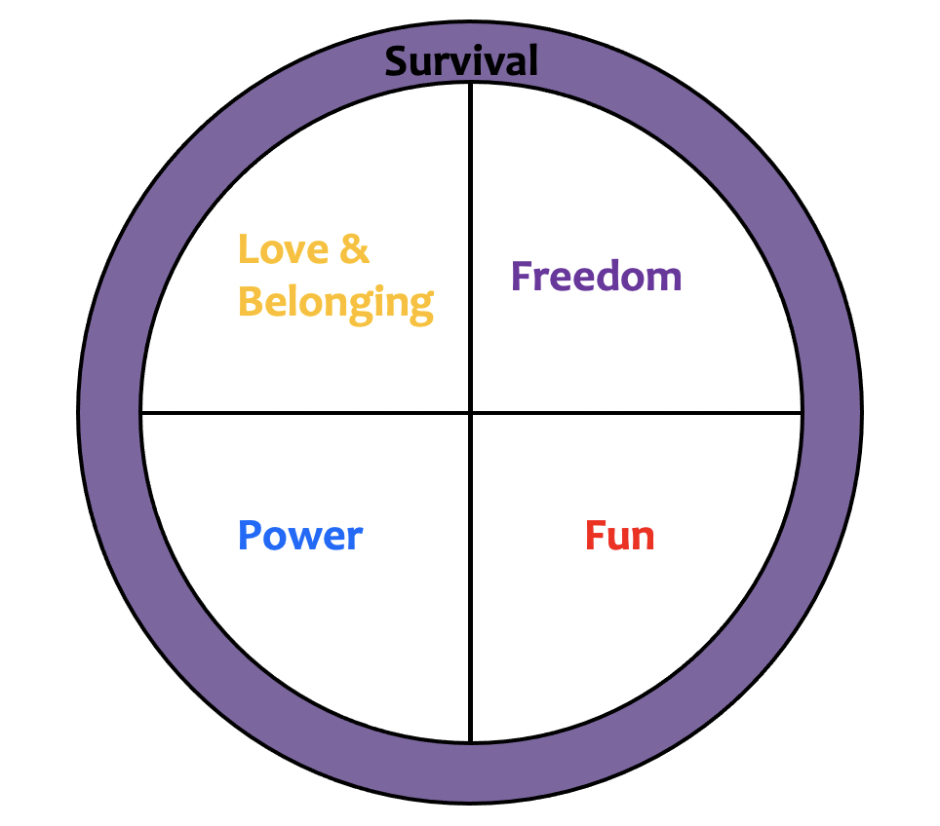
Glasser’s Model of Basic Needs

Slide 4
Safety and Survival
food, water, air
conservation
shelter
health
preparation
security
Power/
Significance
respect
importance
recognition
achievement
courage
competence
impact
being heard
Love and Belonging
friendship
cooperation
involvement
caring
relationships
connecting
trust
Freedom
choices
creativity
independence
autonomy
flexibility
movement
options
Fun
enjoyment
relaxation
recreation
learning
laughter
celebration
exploration
Notes:
Humans have 5 needs - We feel good when a need is satisfied. Our QW pics are our way to we satisfy our needs.
Where do you think each of your sticky notes belongs? Which need is each QW picture about? Which do you think is your strongest need?
Add to the chart

Slide 5
Navigating emotions that feel unfamiliar
Sadness of missing them
Relief
Jealous/envious
Powerlessness
New sense of freedom
Identity
Survivor’s guilt
Anger
Pay attention to your secondary emotions

Slide 6
So, what can we do?
Consider what needs are not being met
Don’t feel the need to pathologies it
Allow the narrative to happen and then pay attention to it
Writing therapy
What is in your control?
What are your habits?
How is it serving you?
Timeline
Don’t feel bound by the stages of grief by Elizabeth Kubler Ross
Denial
Anger
Bargaining
Depression
Acceptance
6th stage: Meaning by David Kessler

Slide 7
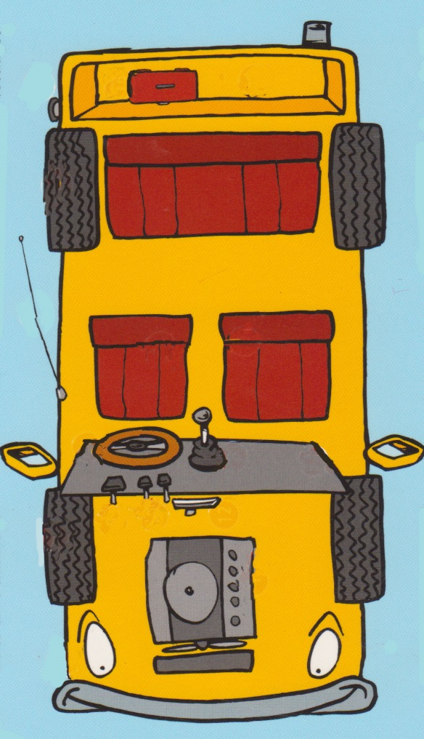
How do you change emotions?
Ask yourself if you are ready to feel differently
Consider the components that can alter feelings
Doing: What are my actions?
Feelings: What are my feelings?
Thinking: What am I thinking?
Physiology: What’s happening in
my body?

Slide 8
Grief during the holidays:
Embrace it and make space for it
Allow yourself to feel and expect a variety of emotions
Set boundaries that work for you
Focus on what’s in your control
Plan ahead
Finding meaning by honoring memories
Create new traditions
Spread kindness to others
Ask for help

Slide 9
Resources
The Dougy Center
www.grief.com
www.goodgrief.com
www.dyingmatters.org
www.thrivecorp.org

