Slide 1



Future Planning Resources
Katie Arnold
Sibling Leadership Network

Slide 2



By joining the network you will:
Become connected to the larger sibling movement happening across the country.
Help strengthen the sibling voice so together we can effect even more change.
www.siblingleadership.org

Slide 3

Barriers to Planning
Anxiety about mortality
Unaware of options and opportunities
Lack of resources and options
Afraid to “burden” siblings
What barriers make it hard for your family to plan for the future?

Slide 4


Siblings Role in
Future Planning
Identify concerns and share
Gather helpful information
Advocate for services and supports
Network with other siblings and families

Slide 5

How to get the conversation started
Talk to your parents and sibling(s)
Think about your role
Think about the people who should be part of the conversation
The Arc’s Center for Future Planning: futureplanning.thearc.org

Slide 6

Areas of Planning:
Financial Planning
Legal Planning
Residential Planning
Building Relationships and Support Networks

Slide 7

Financial Planning
Social Security Disability Insurance (SSDI) - monthly benefit paid to the person with disabilities based on their parent’s Social Security earnings record.
Supplemental Security Income (SSI) - benefits to disabled adults and children who have limited income and resources. This is based on financial need.
Medicaid - provides health coverage to eligible low-income adults, children, pregnant women, and people who are older or who have disabilities. Many people with disabilities use Medicaid to access social and community supports, including housing supports and other long term services.
Medicare - health insurance program for people age 65 or older or people younger with certain disabilities. The program helps with the cost of health care, but it does not cover all medical expenses or the cost of most long-term care.

Slide 8

Special Needs Trusts
Setting up a special needs trust takes an initial financial investment, although in the long run it can also help save money.
Special Needs Alliance: http://www.specialneedsalliance.org/

Slide 9

ABLE Accounts
ABLE = Achieving a Better Life Experience
ABLE Accounts help people with disabilities have a savings account for money that is to supplement, but not supplant, other benefits a person without negatively impacting benefits.
For more information visit: savewithable.com

Slide 10
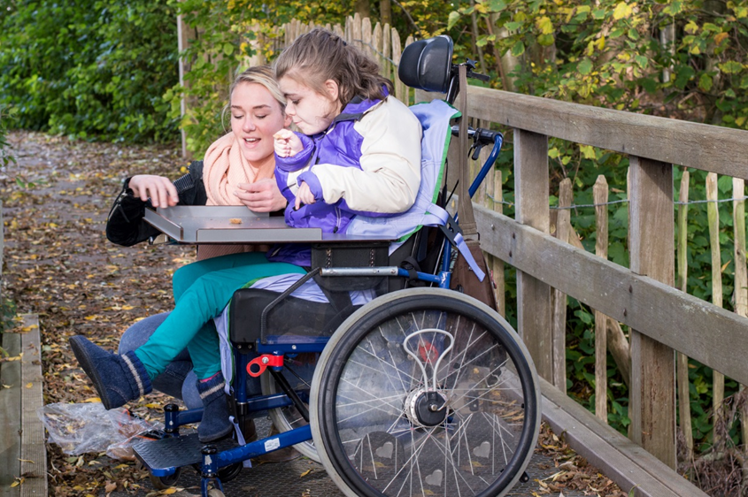
Legal Planning:
Supported Decision-making
A process of supporting an adult with disabilities to make his or her own decisions that fosters the person’s self-determination and does not take away their rights.
Think about ways that you can support your siblings with disabilities to make decisions for themselves.

Slide 11

Supported Decision-making Resources
Sibling Survival Guide chapter on Future Planning
National Resource Center on Supported Decision-Making: http://supporteddecisionmaking.org/about
Supported Decision-making and the Sibling Role: http://www.supporteddecisionmaking.org/legal-resource/supported-decision-making-and-role-siblings-presentation
Autistic Self Advocacy Network : https://autisticadvocacy.org/2016/02/the-right-to-make-choices-new-resource-on-supported-decision-making/
The Arc’s Center for Future Planning:
http://thearc.org/wp-content/uploads/2020/09/Decision-Making-Supports-Center-for-Future-Planning-1.pdf

Slide 12

Surrogate/Substitute
Decision-making
Representative Payee is an individual or organization that serves as a representative to help a person manage his or her government benefits.
Power of attorney is when someone is given authority to make legal and financial decisions on a person’s behalf
Health Care Surrogacy/Proxy is a document that allows an individual to appoint someone to make health care decisions for them if they are or become unable to make these types of decisions by themselves.
Guardianship is when someone is designated to make decisions on behalf of someone else. This should be the last option to consider because it can take away rights of people.

Slide 13

The Future is Now
An evidence-based curriculum for families to plan for the future that is person-centered and family-centered.

Slide 14
Housing Resources and more
For Home and Community Based supports and services for adults with intellectual disabilities, many states have Medicaid waivers that provide residential services and a lot more: employment services, certain therapies, adaptive aids and more.
Every state has different services. Check your State’s Department of Disability (the name is slightly different in each state) to see what is available.

Slide 15

Respite
Respite is when you have someone else look after your loved one while you take a short break
It can be provided in your home or a community location
All people providing care for a loved one need and deserve a break at some point and it can help the person continue to provide great care and be beneficial to the person they are caring for and their whole family.
https://archrespite.org/respitelocator

Slide 16
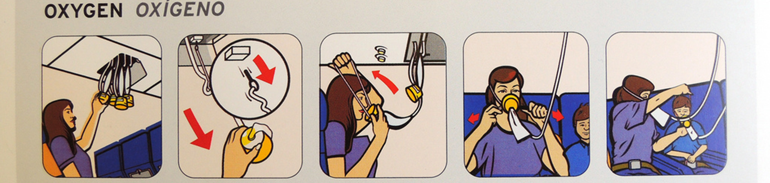
Taking Care of Yourself
Self-care can be beneficial to you as well as everyone around you.
What can you do to take care of yourself?
Make a list of what helps you feel rejuvenated in your life and what is important for you to take time to do for yourself.
Planning for the future can be a form of self-care.

Slide 17

Connect with other sibs:
Connect with Siblings with a Mission:
www.siblingswithamission.org
Join the SLN: siblingleadership.org
Online networks by Sibling Support Project—Find them on Facebook:
  SibTeen: for teenager
  Sib20: for sibs in their 20
  SibNet: for adult sibs

Slide 18

Save the Date!
www.siblingleadership.org

Slide 19

Katie Arnold
Executive Director, Sibling Leadership Network
Katie.Arnold@SiblingLeadership.org

